Slide 1
Real Time Fusion of Radioisotope Direction Estimation and Visual Object Tracking
Elliot Greenlee
08/09/18
Major Professor: Dr. Hairong Qi
Notes:
Hello

Slide 2
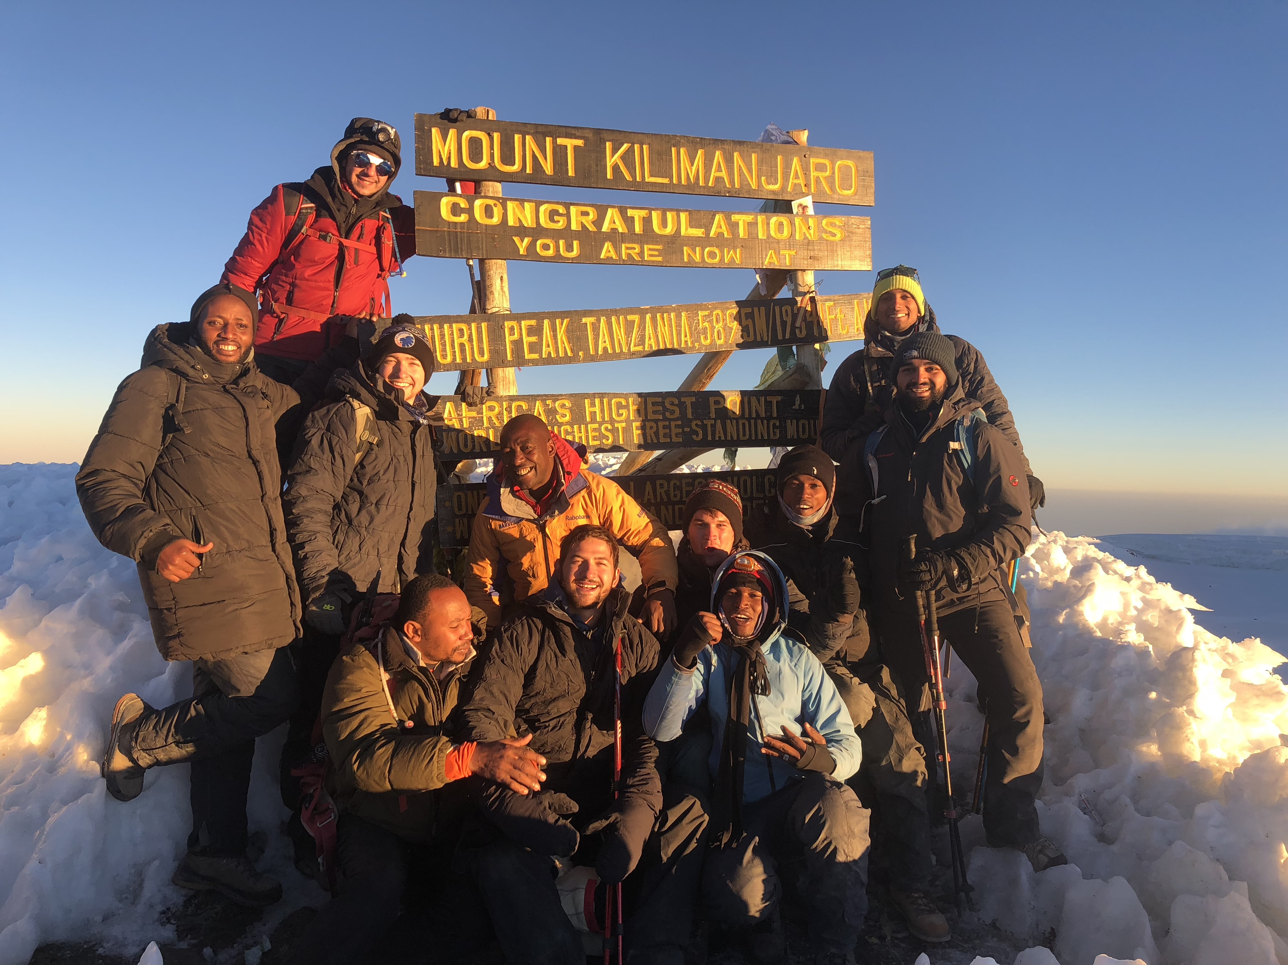
About Me
From Knoxville
UTK CS Bachelor’s - 2016
Engineering Ambassador - 2014
Started VolHacks - 2016
Bodenheimer Fellowship
Security research at ORNL - 2017
Enthusiastic traveler
Notes:
I want to start with a little about me. Six weeks ago I moved to Nashville, but before that I have lived in Knoxville my whole life…

Slide 3
About the Project
IDEAS for WIND
UTK EECS and NE, ORNL, PNNL
DHS funding over five years (15-DNDO-077--001)
Goals
Wearable system, optimize size/weight/power
Spatial tracking and localization
Gamma/neutron detection response
Notes:
The work for this thesis came to me through the IDEAS for WIND project…
Investigation of DEtectors, Algorithms, and Systems for Wearable Intelligent Nuclear Detection

Slide 4
About My Committee
Dr. Hairong Qi – advisor
Sensor networks
Image processing
Machine learning
Information processing
Dr. Jason Hayward
Radiation instrumentation
Nonproliferation technologies
Imaging
Dr. Mark Dean
Advanced computer architectures
Big data systems
Computational science

Slide 5
Motivation – Security
Nuclear nonproliferation
Terrorism
Department of Homeland Security
Disconnect between state-of-the-art research and commercial products
Improve hardware and software
Notes:
The US has goals for nuclear nonproliferation and terrorist prevention…

Slide 6
Motivation – Capability Gap
Localizing moving sources
Pedestrian/backpack detector
Visually tracking carriers
Notes:
Although many defensive systems exist, there is still a capability gap…
Smaller drone and pedestrian detectors are becoming more functional
Vision systems have been used for nuclear detection, but not for tracking of possible carriers
Multiple approaches skirt around the issue of tracking a moving source in real time in any environment
Radtrac exists, but fixed position Fixed position is hard to maintain and can be tampered with
Mobile sensor networks also, but just based on where it is and if it detects

Slide 7
Contributions
Combine state-of-the-art visual detection and tracking methods
Train a detector-ambiguous directional estimator
Fuse into a modular, real time, pedestrian proof of concept algorithm
Notes:
Here are the three explicit contributions of this thesis which contribute towards localizing a moving source…

Slide 8
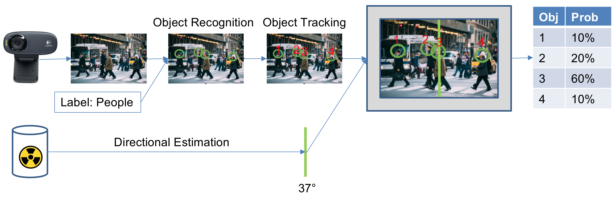
System Overview
Notes:
Here is the overall flow path of the prototype system, from inputs to outputs…

Slide 9
Direction Estimation

Slide 10
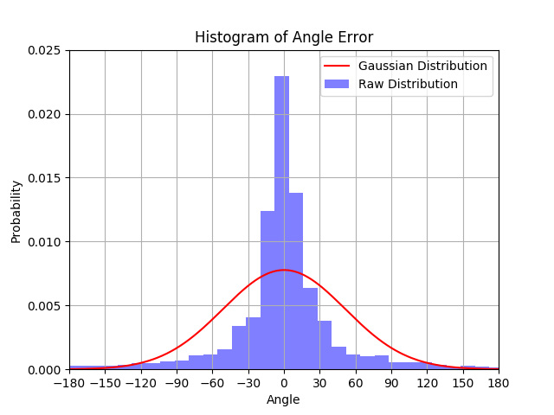
Direction Estimation
Notes:
Estimating direction begins with detecting radiation, and ends with a distribution of angle likelihoods…
Radiation->scintillation->pulses->counts->ratios->regression->distribution

Slide 11
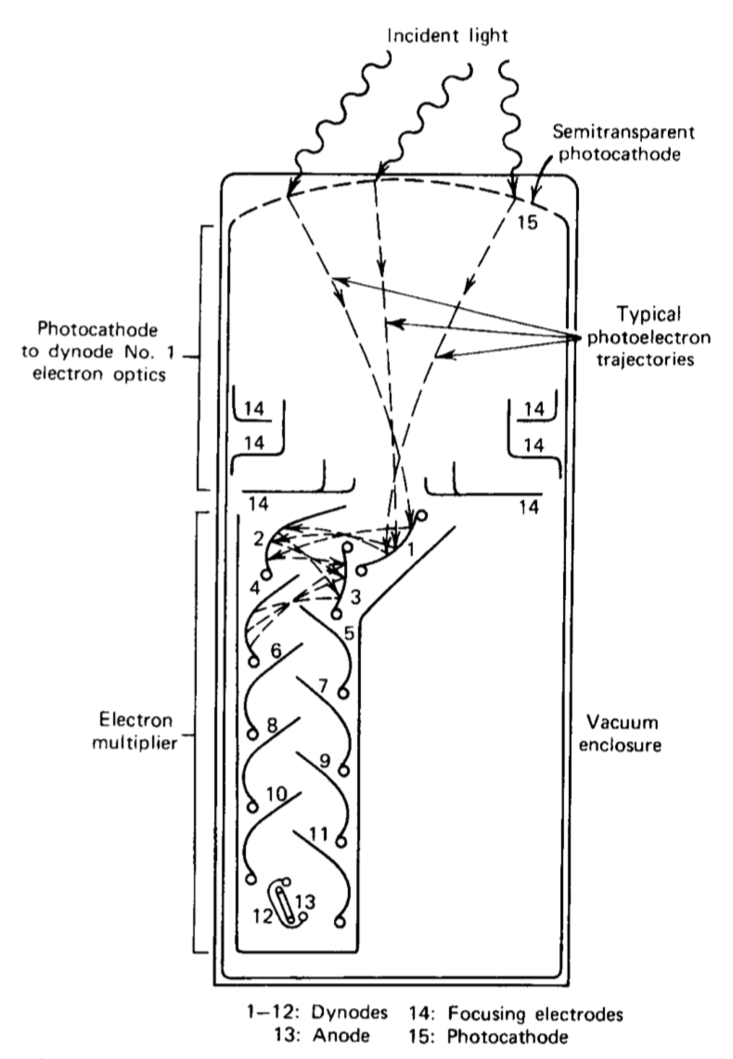
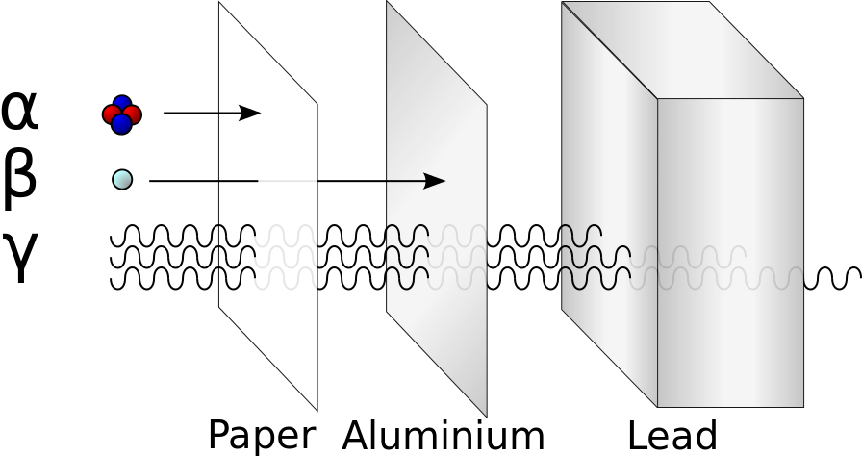
Scintillation
Gamma response
Scintillator fluorescence
Photomultiplication
[1, 2]
Notes:
Because this thesis spans both computer science and nuclear work, I spent time creating introductory sections to help readers catch up.
I don’t want to spend as much time doing that during this defense, but please interrupt me and ask questions if anything isn’t clear, or you feel I have assumed some piece of knowledge.
Ionizing radiation, unstable isotopes. Gamma are electromagnetic photons from nucleus. Cobalt 60, cesium 137.
Sodium iodides make the right fluorescence and not phosphorescence
Photocathode absorbs photons, loses electrons which are accelerated to hit the dynode, releasing more electrons. Happens many times in cascade

Slide 12
Estimation Methods
Applications
Direction estimation
Error distribution
Categorization
Classification/Regression
Supervised/Unsupervised
Parametric/Nonparametric
Notes:
The direction estimation flow path is designed to be agnostic to the specific algorithm used…

Slide 13
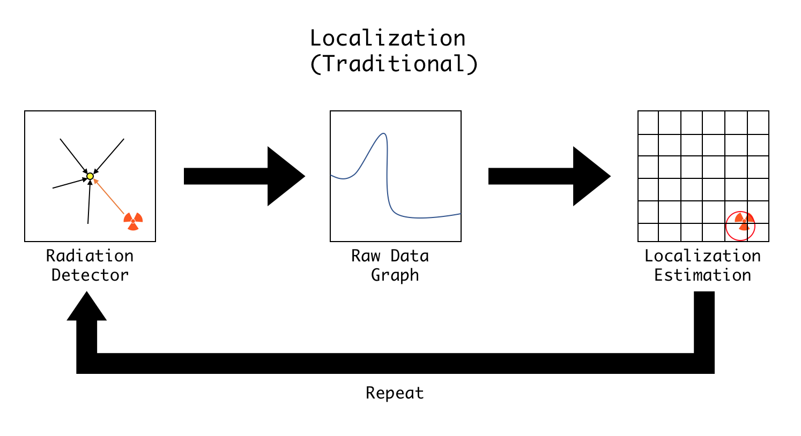
Previous Methods
Detection, identification, localization
Input reconstruction challenge
Radiation contexts
Poisson statistics
Stationary detector
Moving detector
Moving source
Notes:
There are three major reconnaissance tasks possible using a nuclear detector setup…
Other contexts (portal, aerial, urban, network, etc)
Other ways to pose: monte carlo/Boltzmann, talk about each (Monte Carlo N-Particle)
Moving detector means field mapping of intensity (drone disaster, helicopter)
Moving source posed as crossing checkpoints, or getting close or not close to detector network units

Slide 14
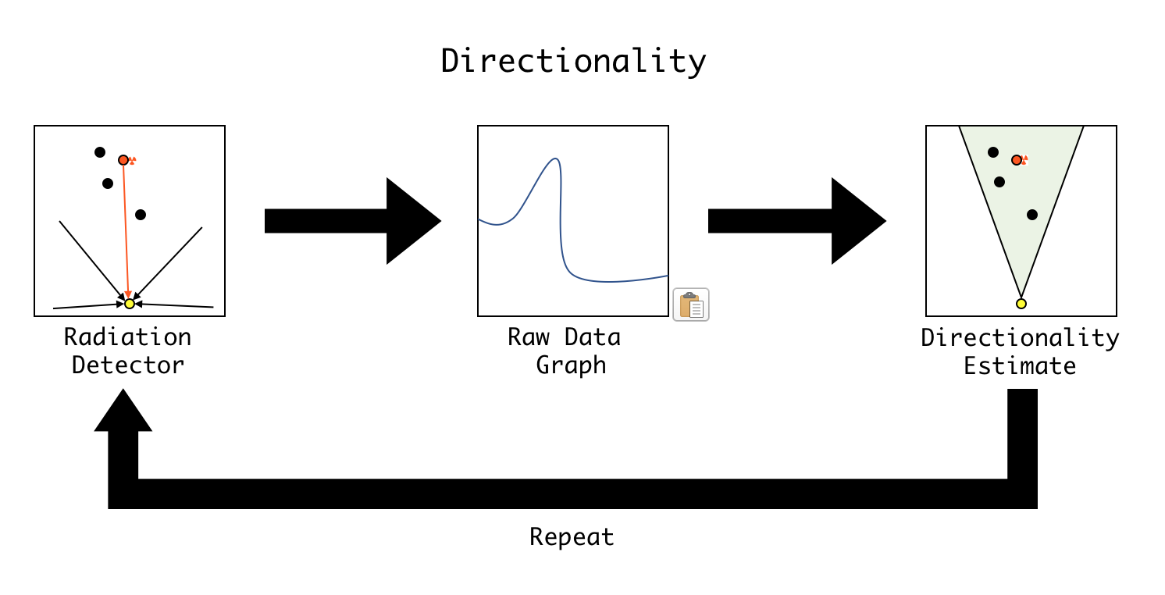
Posing Direction Estimation
Notes:
In order to make a step towards real time localization, a more simplified input reconstruction problem is posed…

Slide 15
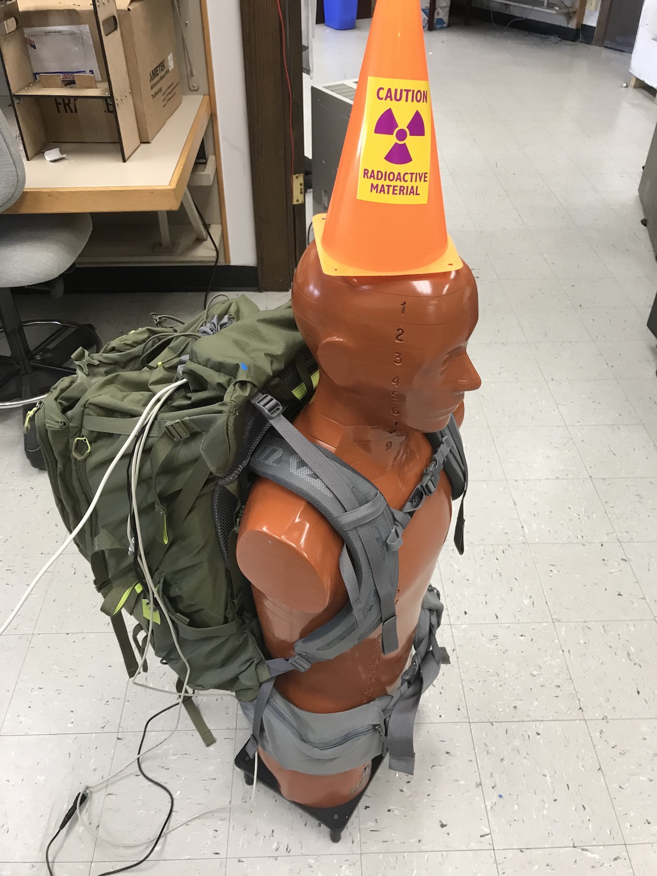
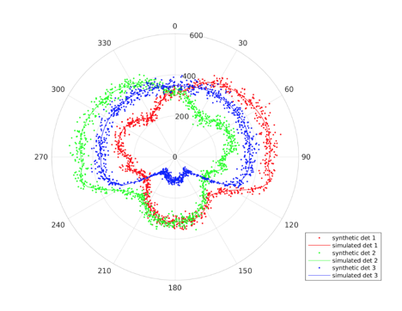
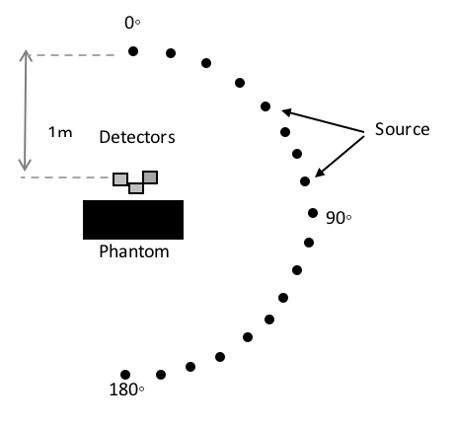
Datasets
Total Counts
Interval Counts
Ratios
[Carl Britt]
Notes:
To investigate this method, a synthetic and lab dataset were used…
Simulated
threshold energy of 60 keV for the simulated, 200 microcurie source
performing a Poisson sample using the simu-
lated count rate as the mean value, then multiplying by the collection time of one second
Real
32 keV in the NaI’s, so that is a reasonable lower threshold for them. CLYC, lets say its currently 100 keV
A: Cs-137/8.15 μCi/0.53m,
B: Cs-137/8.15 μCi/0.91m,
C: Cs-137/9.91 μCi/0.91m,
D: Cs- 137/18.06 μCi/0.91m
E: Co-60/0.31 μCi/0.91m

Slide 16
Datasets
 | Synthetic Data | Lab Data
Source Strength | 200 µCi | 0.3, 8, 10, 18 µCi
Count Time | 1 second | 0.25, 0.5, 1, …, 8 seconds
Distance | 1 meter | 0.5, 1.0 meters
Isotope | Cesium-137 | Cesium-137/Cobalt-60
Background | No | Yes
Notes:
To investigate this method, a synthetic and lab dataset were used…
Simulated
threshold energy of 60 keV for the simulated, 200 microcurie source
performing a Poisson sample using the simu-
lated count rate as the mean value, then multiplying by the collection time of one second
Real
32 keV in the NaI’s, so that is a reasonable lower threshold for them. CLYC, lets say its currently 100 keV
A: Cs-137/8.15 μCi/0.53m,
B: Cs-137/8.15 μCi/0.91m,
C: Cs-137/9.91 μCi/0.91m,
D: Cs- 137/18.06 μCi/0.91m
E: Co-60/0.31 μCi/0.91m

Slide 17
Results – Synthetic Regression
Regression Method | RMSE
Random Forest | 7°
K Nearest Neighbors | 8°
Gradient Boosting | 10°
Decision Tree | 11°
Logistic | 19°
Support Vector | 20°
AdaBoost | 22°
Multi-Layer Perceptron | 38°
Stochastic Gradient Descent | 42°
Linear | 43°
Bayesian Ridge | 45°

Slide 18
Results – Laboratory Regression
Regression Method | A | B | C | D | E
Gradient Boosting | 16.2° | 46.9° | 40.7° | 29.7° | 90.8°
Random Forest | 12.5° | 49.5° | 40.9° | 28.1° | 97.8°
K Nearest Neighbors | 11.2° | 51.8° | 41.9° | 29.7° | 97.6°
Linear | 60.7° | 58.5° | 60.0° | 51.4° | 90.2°
Bayesian Ridge | 60.7° | 58.7° | 59.4° | 51.4° | 90.1°
AdaBoost | 17.8° | 48.9° | 45.4° | 42.7° | 91.5°
Support Vector | 54.6° | 59.2° | 58.4° | 55.2° | 95.7°
Decision Tree | 17.8° | 59.4° | 57.4° | 34.5° | 128.3°
Logistic | 34.8° | 66.2° | 55.5° | 48.8° | 107.5°
Gradient Descent | 74.7° | 180.0° | 76.6° | 53.7° | 180.0°
Multi-Layer Perceptron | 66.5° | 84.6° | 78.3° | 59.5° | 101.8°
Notes:
A: Cs-137/8.15 μCi/0.53m,
B: Cs-137/8.15 μCi/0.91m,
C: Cs-137/9.91 μCi/0.91m,
D: Cs- 137/18.06 μCi/0.91m
E: Co-60/0.31 μCi/0.91m

Slide 19
Results – Timing
Counting Period (seconds) | RMSE
0.25 | 61.8°
0.5 | 56.1°
1.0 | 49.1°
2.0 | 38.8°
4.0 | 27.7°
8.0 | 26.6°

Slide 20
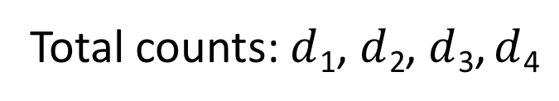
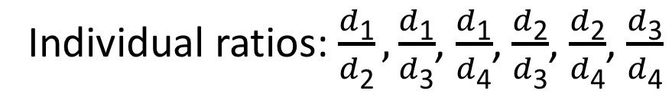
Results – Ratios
Total counts: $d$₁, $d$₂, $d$₃, $d$₄
Ratio Method | RMSE
Total Counts | 92.5°
Individual Ratios | 48.1°
Sum Ratios | 48.8°
Individual ratios: $\frac{d\text{1}}{d\text{2}},\frac{d\text{1}}{d\text{3}}$, $\frac{d\text{1}}{d\text{4}}$, $\frac{d\text{2}}{d\text{3}}$, $\frac{d\text{2}}{d\text{4}}$, $\frac{d\text{3}}{d\text{4}}$
Sum ratios: $\frac{d\text{1}}{d\text{2}\text{+}d\text{3}\text{+}d\text{4}},\frac{d\text{2}}{d\text{1}\text{+}d\text{3}\text{+}d\text{4}}$, $\frac{d\text{3}}{d\text{1}\text{+}d\text{2}\text{+}d\text{4}}$, $\frac{d\text{4}}{d\text{1}\text{+}d\text{2}\text{+}d\text{3}}$
Notes:
Switching source strength at 1 meter (8 – 18)

Slide 21
Results – Ratios
Source Distance | Individual Ratio Testing Error | Raw Count Testing Error
0.53 m | 16.2° | 10.5°
0.91 m | 46.9° | 42.8°
0.53 m to 0.91 m | 64.9° | 129.5°
0.91 m to 0.53 m | 39.2° | 89.1°

Slide 22
Results – Ratios
Source Strength | Individual Ratio Testing Error | Raw Count Testing Error
8.15 µCi | 46.9° | 42.9°
18.06 µCi | 29.7° | 28.1°
8.15 µCi to 18.06 µCi | 48.1° | 91.1°
18.06 µCi to 8.15 µCi | 77.9° | 93.0°

Slide 23
Overall Accuracy
Method | Accuracy
ARBL | 10-20 meters²
Hybrid Optimization and Bayesian Inference | <0.2 meters²
Bayesian Metropolis | 10 meters²
UAV | 5 meters²
Geometric Occlusion | 1°
Fuzzy Logic | 3-22°
Ours | 16-50°
[4, 5, 6, 7, 8, 9]
Notes:
Comparing this method to other methods is challenging
adaptively reevaluated bayesian localization (arbl): a novel technique for radiological source localization 10-20 m, helicopter, one detector
hybrid optimization and bayesian inference techniques for a non-smooth radiation detection problem <0.5 m, simulated buildings, sensor network
Bayesian Metropolis methods applied to sensor networks for radiation source localization 10 m, simulated buildings, sensor network, use some of same data as hybrid opt paper
uav-based multiple source localization and contour mapping of radiation fields
5 m, disaster localization for ROI, all simulation, one detector
Exploitation of geometric occlusion and covariance spectroscopy in a gamma sensor array 100 micro or millicurie, within 3 m, doesn’t say how long. Uses asymmetry vs angle linear relationship 1 degree
Detection and positioning of radioactive sources using a four-detector response algorithm 3-22 degrees, 10 micro, within 0.5 m, 60 or 600 seconds or 0.5 seconds without clear accuracy numbers

Slide 24
Direction Estimation
Notes:
The result of all this work is again a distribution of regression estimates

Slide 25
Visual Object Tracking

Slide 26
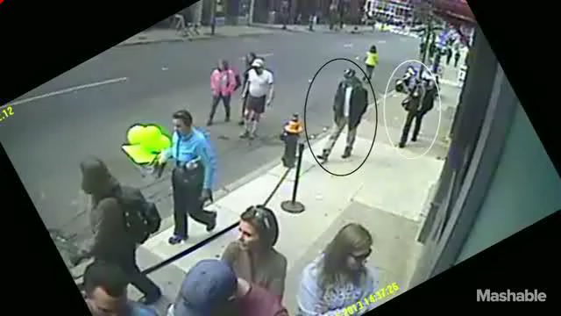
Vision – Example One

Slide 27
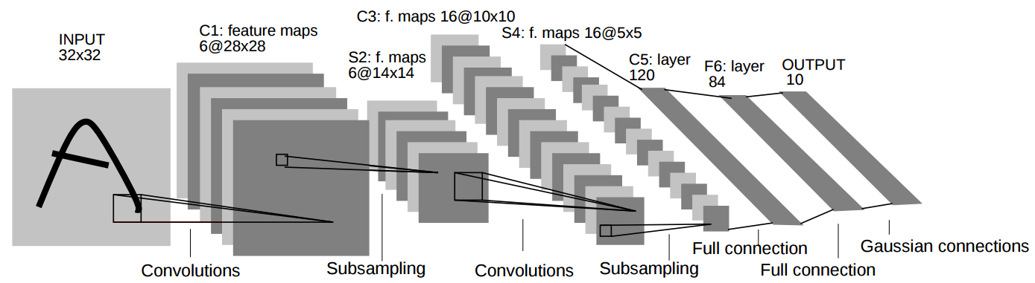
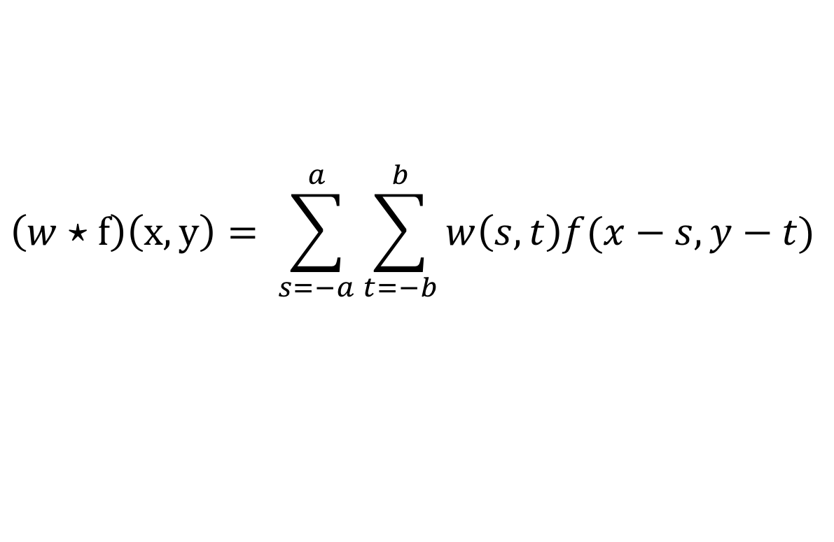
Convolution Neural Networks
$$\left(w⋆f\right)\left(x,y\right)= \sum_{s=−a}^{a}{\sum_{t=−b}^{b}{w\left(s,t\right)f(x−s, y−t)}}$$
[10, 11]
Notes:
What is this network for
We could use regular neural nets but
We learn weights like the equation
lower level to high level features, then predict
Convolution is the process of adding each element of the image to its local neighbors, weighted by the kernel
w is the kernel of size M x N such that a = (M −1)/2 and b = (N −1)/2, f(x,y) is the image, and ⋆ is the convolution operator

Slide 28
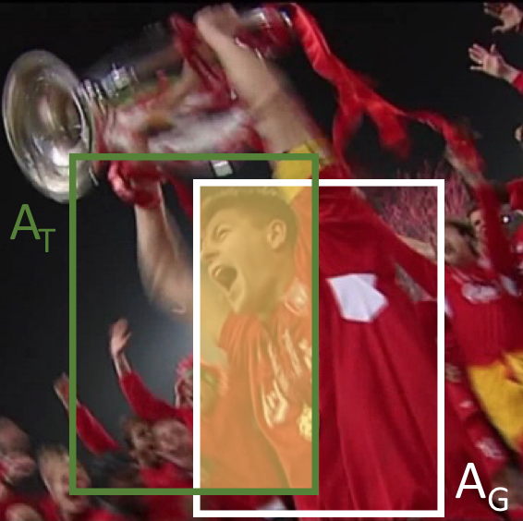
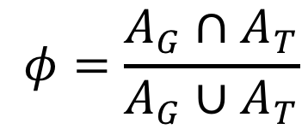
Object Detection
Intersection Over Union (IoU)
Mean Average Precision (mAP)
$$φ=\frac{A_{G}∩A_{T}}{A_{G}∪A_{T}}$$
Notes:
robotic interaction, autonomous driving, and assistive devices
occlusions, illuminations, pose variations, variable resolutions, and object similarity
detection tasks are highly dependent on contextual information
Possible classes are known (sometimes not true like YOLOv2)
Used to be hand coded feature pipelines
Move to one and two stage CNN methods (region proposal, detection/localization)

Slide 29
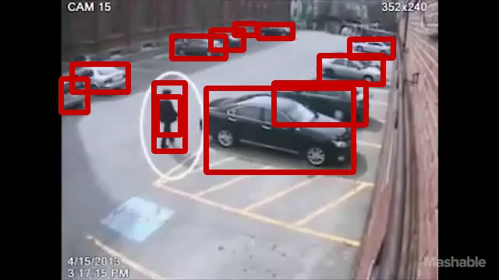
YOLOv3 – Example One

Slide 30
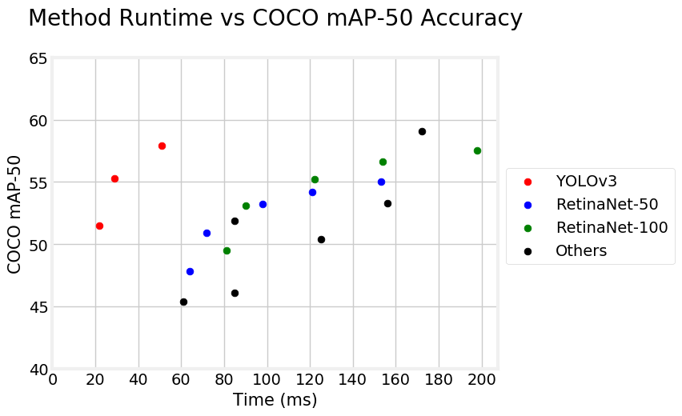
YOLOv3 Performance
Notes:
Talk about ability to switch speed and accuracy without retraining

Slide 31
YOLOv3 Performance
Architecture | Network | Boston 1 | Boston 2 | Boston 3 | Boston 4 | Boston 5 | Boston 6
GPU | Tiny | 52.8 fps | 50.8 fps | 55.0 fps | 53.8 fps | 52.4 fps | 51.6 fps
GPU | Normal | 22.0 fps | 22.0 fps | 22.2 fps | 21.3 fps | 21.5 fps | 21.9 fps
CPU | Tiny | 1.4 fps | 1.4 fps | 1.4 fps | 1.4 fps | 1.4 fps | 1.2 fps
CPU | Normal | 0.13 fps | 0.13 fps | 0.13 fps | 0.13 fps | 0.13 fps | 0.14 fps
Notes:
Talk about ability to switch speed and accuracy without retraining

Slide 32
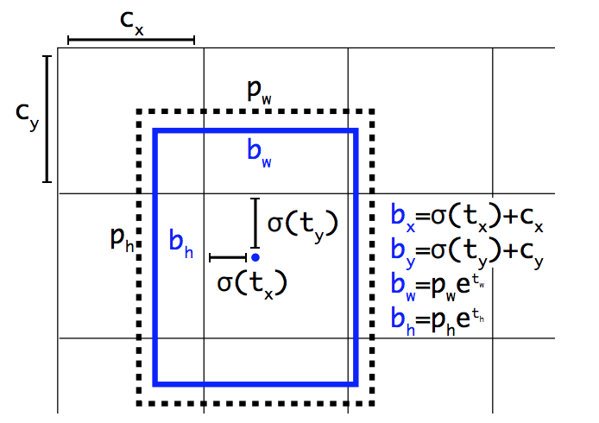
YOLOv3 Predictions
[12]
Notes:
Talk about using kmeans to get clusters of box sizes
Cx, cy is cell offset
Pw and ph are priors for bounding box
X and y are center of box
predict the center coordinates of the box relative to the location of filter application using a sigmoid function

Slide 33
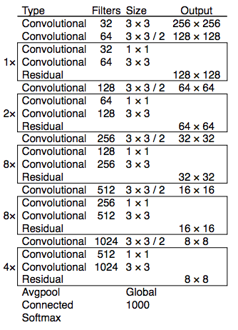
YOLOv3 Network
[12]

Slide 34
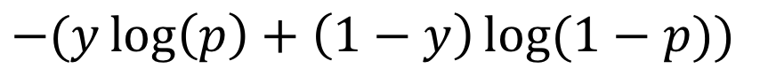
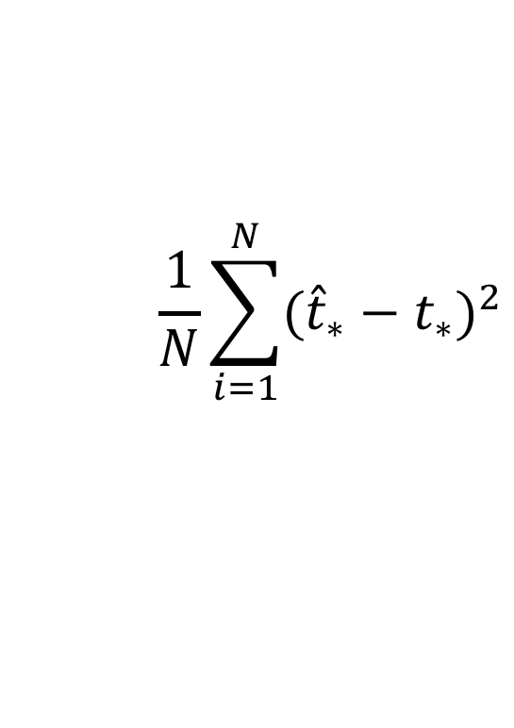
YOLOv3 Training
Pretraining – classification
Training – detection
$$−(y\log\left(p\right)+\left(1−y\right)\log{(1−p))}$$
$$\frac{1}{N}\sum_{i=1}^{N}{{({\hat{t}}_{∗}−t_{∗})}^{2}}$$
[12]
Notes:
First trained on ImageNet with binary cross entropy
Next trained on detection datasets using sum of squared error

Slide 35
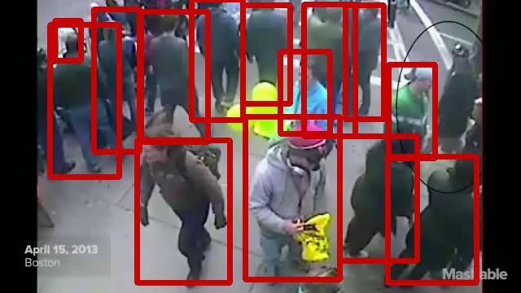
YOLOv3 – Example Two

Slide 36
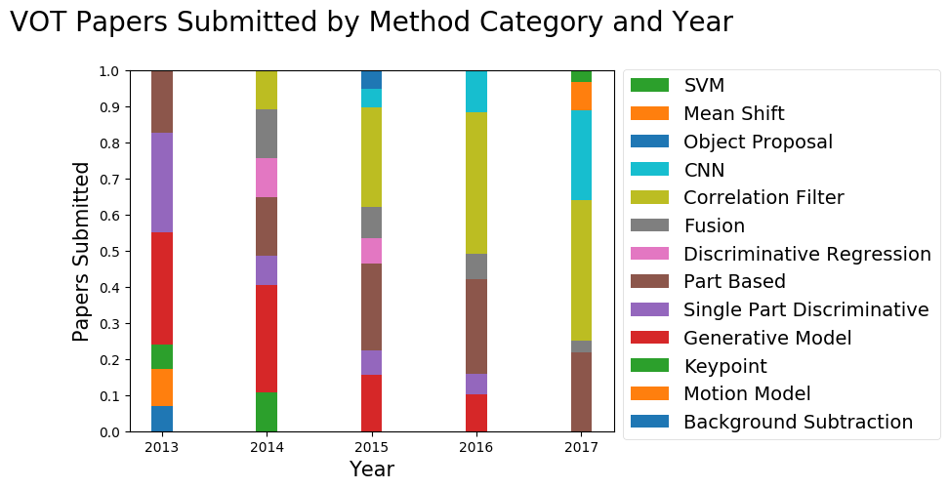
Object Tracking
[13]
Notes:
What makes this challenging
Individual video sequences have arbitrary characteristics and contain a variety of objects, each with a different shape, appearance, and movement style. Objects that appear in the background of one sequence could be the target in the next. Additionally, confusing changes such as deformation, motion blur, camera movement, and illuminations can occur across frames in a single sequence. Objects can be transparent, look similar to clutter in the background,
25
and move erratically.
Hard to get video data
Generative vs discriminative
Talk about each different type of method (9 of 10 in 2017 were CNN base) pretraining backbone offline on detection

Slide 37
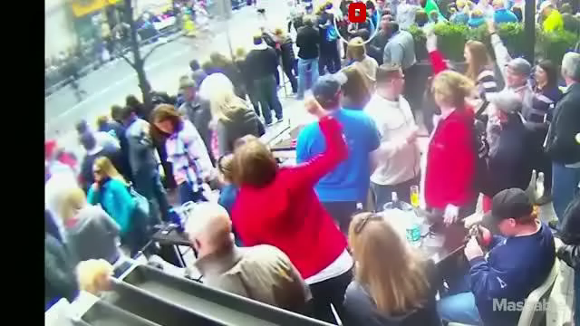
SiamFC – Example One

Slide 38
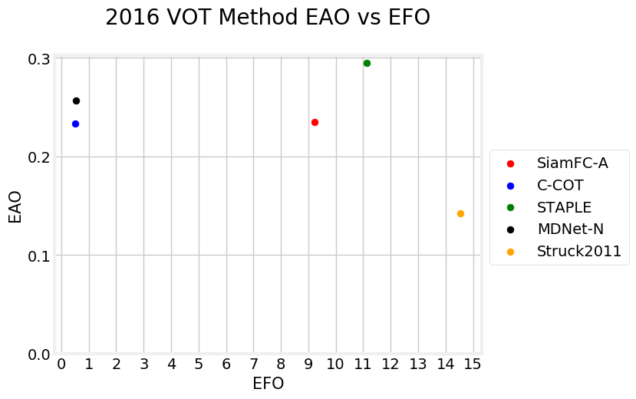
SiamFC Performance
Method | EAO | A | R
SiamFC | 0.182 | 0.502 | 0.604
CSRDCF++ | 0.212 | 0.459 | 0.398
ECOhc | 0.177 | 0.494 | 0.571
Staple | 0.170 | 0.530 | 0.688
KFebT | 0.169 | 0.451 | 0.684
[14, 15, 16, 17, 18]

Slide 39
SiamFC Performance
Architecture | Boston 1 | Boston 2 | Boston 3 | Boston 4 | Boston 5 | Boston 6
GPU | 10.3 fps | 9.9 fps | 10.9 fps | 11.1 fps | 10.4 fps | 10.4 fps
CPU | 1.4 fps | 1.4 fps | 1.4 fps | 1.3 fps | 1.2 fps | 1.3 fps

Slide 40
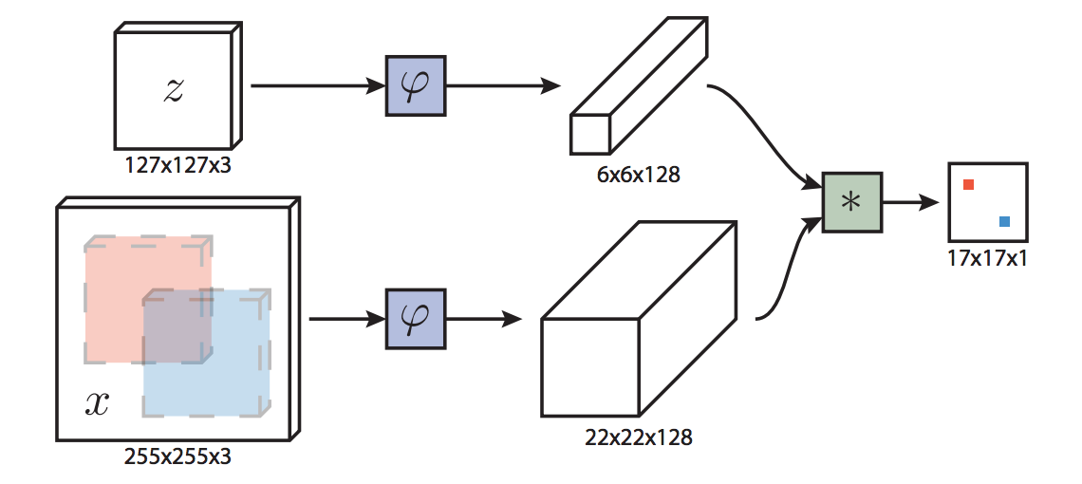
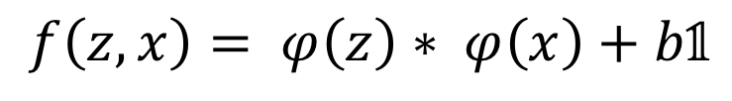
SiamFC Predictions
$$f\left(z, x\right)= φ\left(z\right)∗ φ\left(x\right)+b𝟙$$
[14]
Notes:
Phi is the convolutional embedding
* Is the cross correlation layer (simple similarity metric). Cross correlation is the same as convolution but plus signs
Fully convolutional with respect to the candidate X

Slide 41
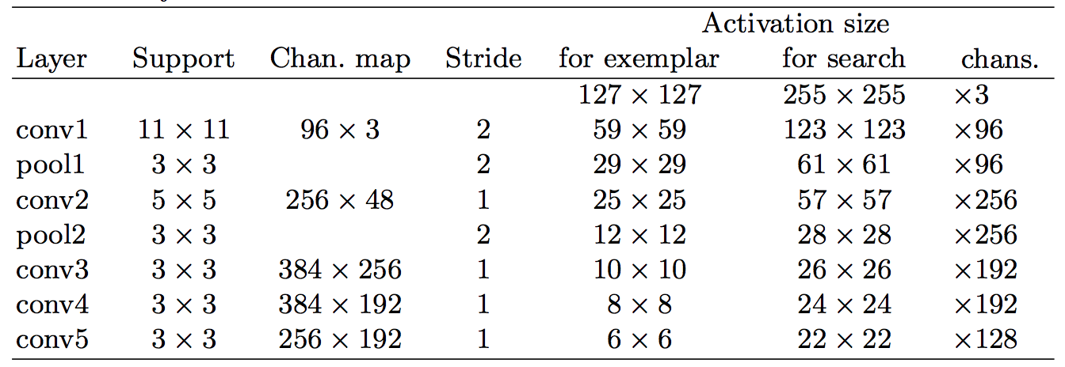
SiamFC Network
[14]
Notes:
No padding!
Fully convolutional
Based on alexnet

Slide 42
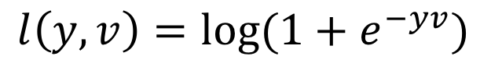
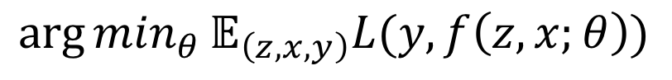
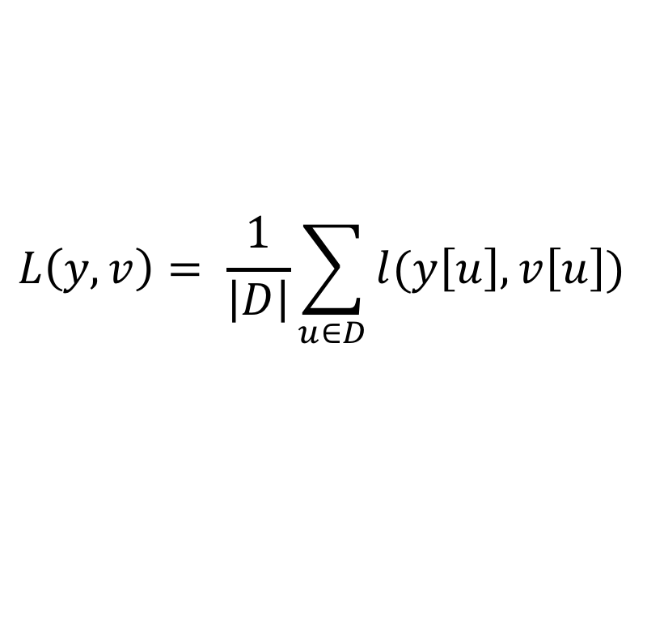
SiamFC Training
$$\arg{\min_{θ}}𝔼_{\left(z,x,y\right)}L(y,f\left(z,x;θ\right))$$
$$L\left(y,v\right)= \frac{1}{\left|D\right|}\sum_{u∈D}{l(y\left[u\right], v\left[u\right])}$$
$$l\left(y,v\right)=\log{(1+e^{−yv})}$$
[14]
Notes:
Discriminative; positive and negative pairs
l is logistic loss
L is loss of score map, mean of individual losses
Stochastic gradient descent for conv-net theta applied to that arg min problem
v is the real-valued score of a single exemplar-candidate pair and y ∈ {+1, −1} is its ground-truth label. you get v from the cross correlation of features
u is a position in D (the score map)
Exemplar and search(larger) images are chosen from same video, and normalize so the object is the same size
Negative samples are weighted less because there are so many compared to the positives samples

Slide 43
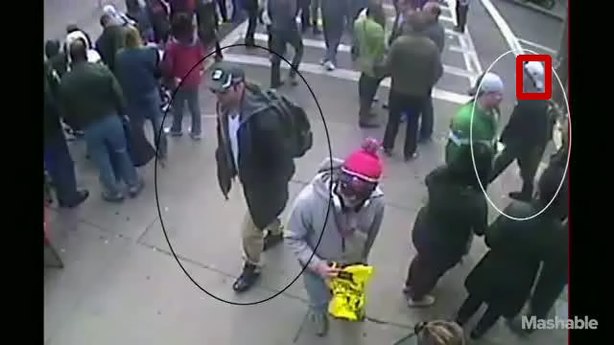
SiamFC – Example Two

Slide 44
Vision
Human triggers
YOLOv3 detects objects
Program initializes one thread per object
SiamFC tracks one object
Program converts to angle

Slide 45
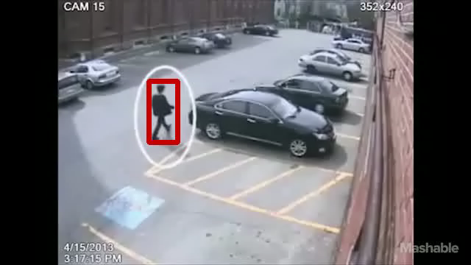
Vision – Example Two

Slide 46
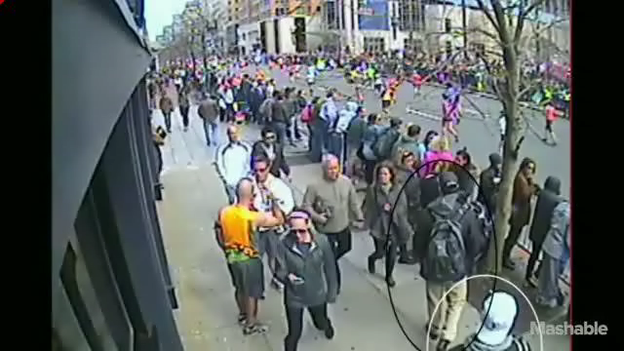
Vision – Example Three

Slide 47
Method Fusion

Slide 48
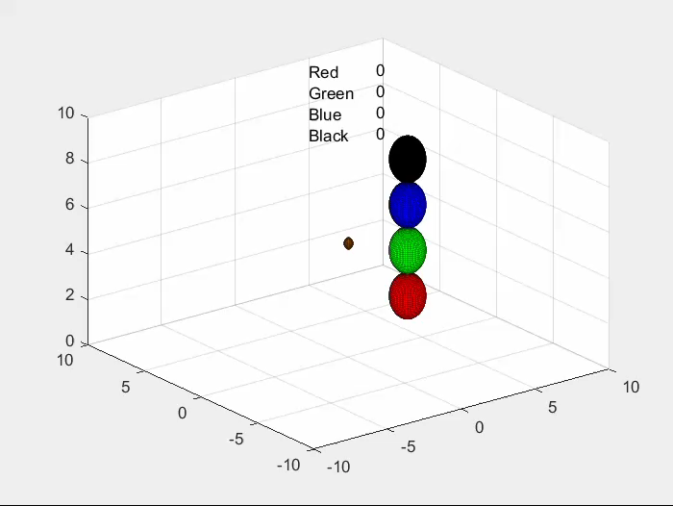
Fusion – Example One
[Steven Patrick]

Slide 49
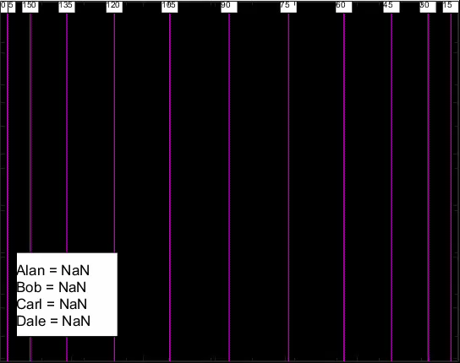
Fusion – Example Two
[Steven Patrick]

Slide 50
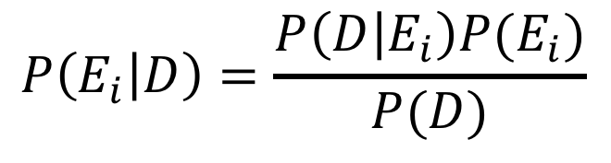
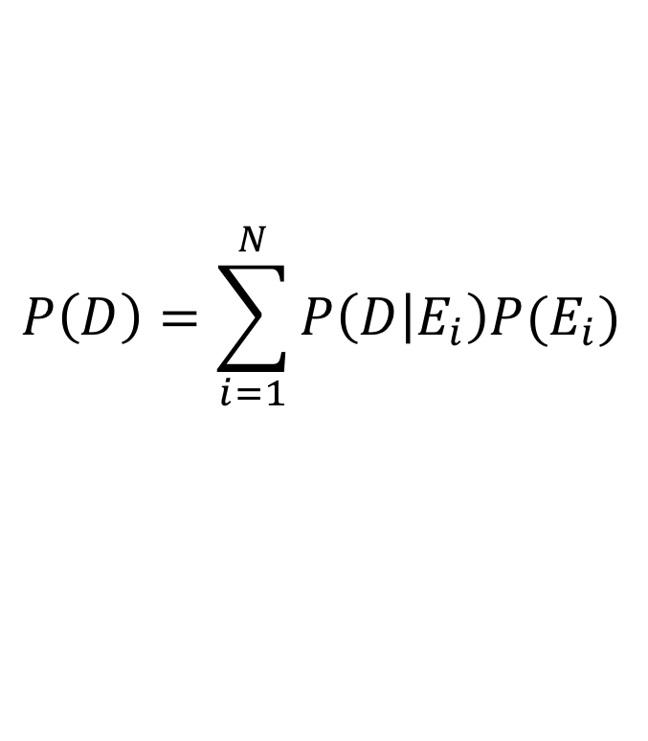
Formalism
$$P\left(E_{i} | D\right)=\frac{P\left(D | E_{i}\right)P(E_{i})}{P(D)}$$
$$P\left(D\right)=\sum_{i=1}^{N}{P\left(D | E_{i}\right)P(E_{i})}$$
Notes:
D is data obtained
E is event that a certain person is the carrier
N objects, I runs from 1 to N
Equal priors to start

Slide 51
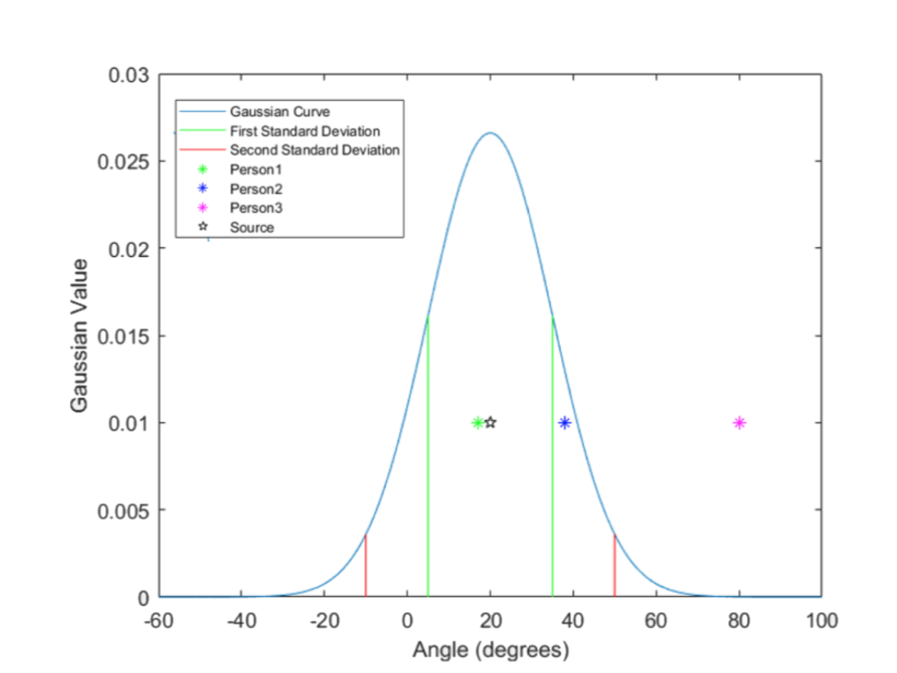

Likelihood Curve – $P\left(D | E_{i}\right)$

Slide 52
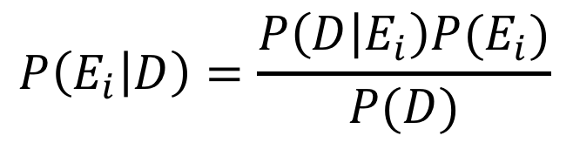
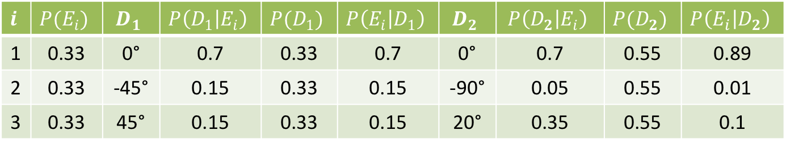
Two Iteration Example
$$i$$ | $$P(E_{i})$$ | $$D_{1}$$ | $$P\left(D_{1} | E_{i}\right)$$ | $$P(D_{1})$$ | $$P\left(E_{i} | D_{1}\right)$$ | $$D_{2}$$ | $$P\left(D_{2} | E_{i}\right)$$ | $$P(D_{2})$$ | $$P\left(E_{i} | D_{2}\right)$$
1 | 0.33 | 0° | 0.7 | 0.33 | 0.7 | 0° | 0.7 | 0.55 | 0.89
2 | 0.33 | -45° | 0.15 | 0.33 | 0.15 | -90° | 0.05 | 0.55 | 0.01
3 | 0.33 | 45° | 0.15 | 0.33 | 0.15 | 20° | 0.35 | 0.55 | 0.1
$$P\left(E_{i} | D\right)=\frac{P\left(D | E_{i}\right)P(E_{i})}{P(D)}$$

Slide 53
Confidence
Iterations to 80% Confidence
Gaussian Variance
 | 10° | 25° | 50°
10° | 6 | 43 | 60
30° | 1 | 5 | 14
45° | 1 | 1 | 6
Angle of Separation
Notes:
Assume 5 people are standing still. 1 at 0 with the source, and 4 at some angle of separation. Given the RMSE or variance of the regression method, how many iterations does it take to reach 80% confidence in the real person.

Slide 54
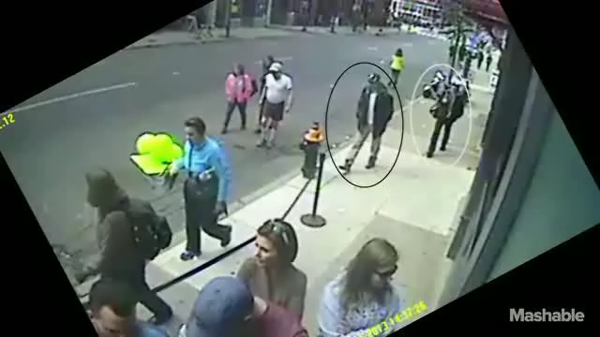
Fusion – Example Three

Slide 55
System Overview
Notes:
Now that we have looked at each component, let’s review how they are connected

Slide 56
Contributions
Combine state-of-the-art visual detection and tracking methods
Train a detector-ambiguous directional estimator
Fuse into a modular, real time, pedestrian proof of concept algorithm
Notes:
Here are the three explicit contributions of this thesis which contribute towards localizing a moving source…

Slide 57
Future Work
Improve regression accuracy
Evaluate direction estimation with more training data
Update state-of-the-art visual tracking methods
Evaluate the fusion method on simultaneous nuclear and visual data
Notes:
This thesis work will continue as part of the IDEAS for WIND project over the next few years…

Slide 58
Questions?

Slide 59

Acknowledgement
Thanks to U.S. Department of Homeland Security Award 15-DNDO-077--001 for the support of this work

Slide 60
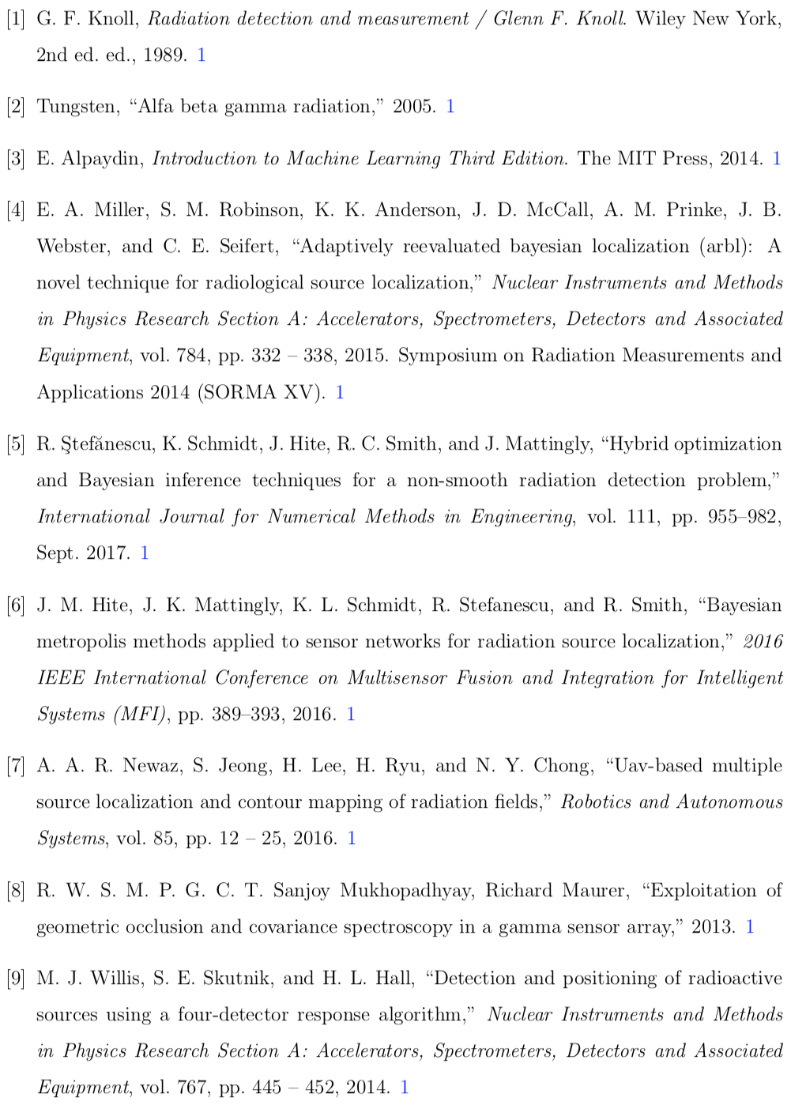
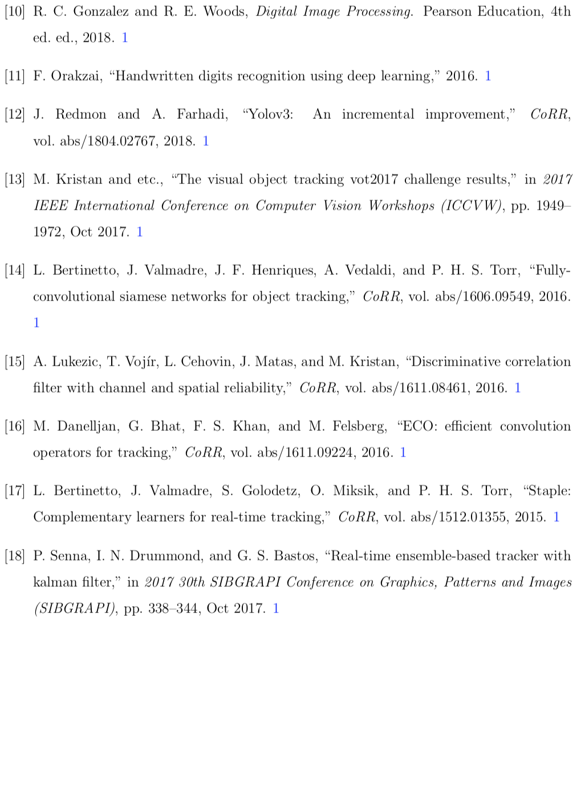
References

Slide 61
Real Time Fusion of Radioisotope Direction Estimation and Visual Object Tracking
Elliot Greenlee
08/09/18
Major Professor: Dr. Hairong Qi

Slide 62
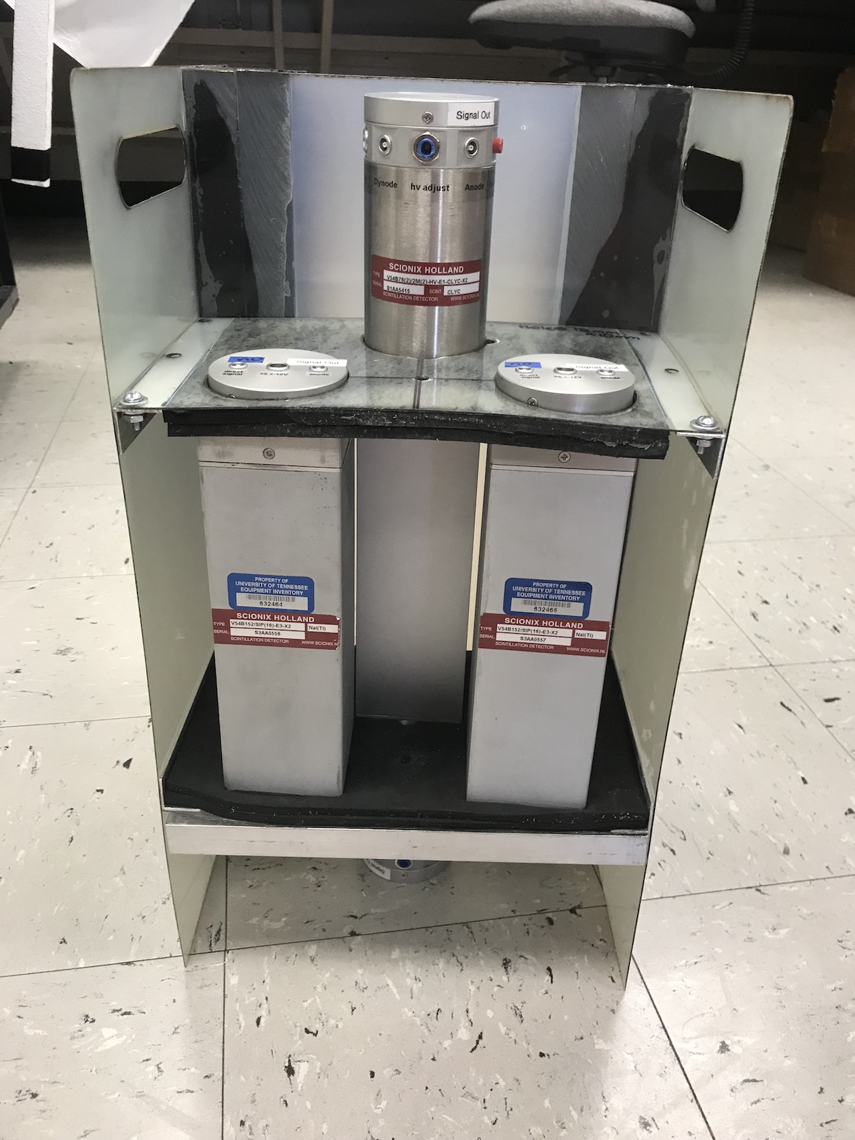

Slide 63
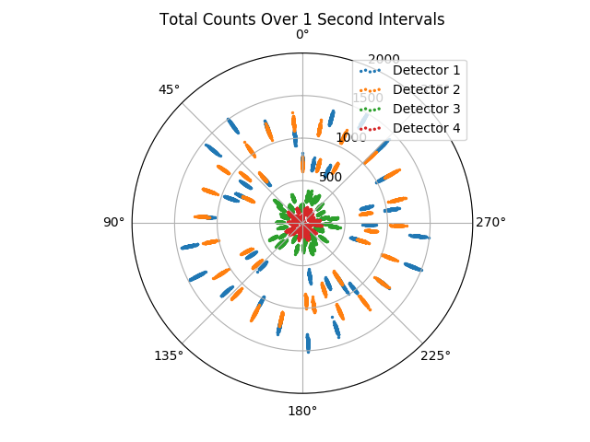

Slide 64
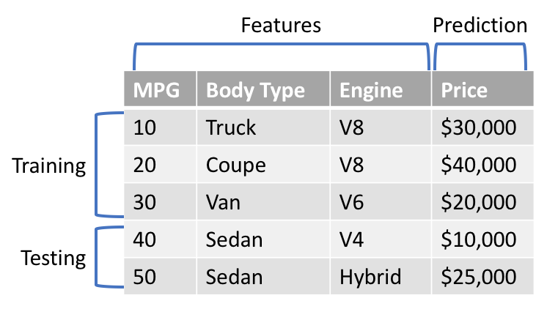

Slide 65
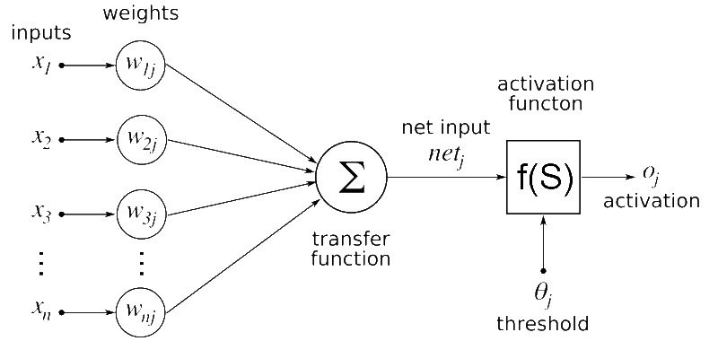

Slide 66


Slide 67


Slide 68

Notes:
To start, precision is calculated as TP/(TP +FP) and recall is calculated as TP/(TP +FN) where TP is the number of true positives, FP is the number of false positives, and FN is the number of false negatives. Consider an image with six objects. After sorting the five detection results by confidence, predictions two and five are missed such that the IoU is less than 0.5. This means that the top five predictions have a precision of 3/5 and a recall of 3/6. For the other top four, top
40
six, etc predictions, the recall value will vary from 0 to 1.0. In order to calculate AP, the average value of all of the maximum precisions stepping by 0.1 from 0 to 1.0 recall is taken. The maximum precision for a given recall value is the maximum of the precision values where the recall is higher than the given value. For the COCO dataset, mAP is used. In this case, AP is averaged over an IoU from 0.5 to 0.95 in steps of 0.05

Slide 69


Slide 70


Notes:
Bernoulli distribution
Log is easier to work with
K=y

Slide 71

Notes:
Like other boosting methods, gradient boosting combines weak "learners" into a single strong learner in an iterative fashion. It is easiest to explain in the least-squares regressionsetting, where the goal is to "teach" a model {\displaystyle F} to predict values of the form {\displaystyle {\hat {y}}=F(x)} by minimizing the mean squared error {\displaystyle 1/n\sum _{i}({\hat {y}}_{i}-y_{i})^{2}}, where {\displaystyle i} indexes over some training set of size {\displaystyle n} of actual values of the output variable {\displaystyle y}.
At each stage {\displaystyle m}, {\displaystyle 1\leq m\leq M}, of gradient boosting, it may be assumed that there is some imperfect model {\displaystyle F_{m}} (at the outset, a very weak model that just predicts the mean y in the training set could be used). The gradient boosting algorithm improves on {\displaystyle F_{m}} by constructing a new model that adds an estimator h to provide a better model: {\displaystyle F_{m+1}(x)=F_{m}(x)+h(x)}. To find {\displaystyle h}, the gradient boosting solution starts with the observation that a perfect h would imply
{\displaystyle F_{m+1}(x)=F_{m}(x)+h(x)=y}or, equivalently,
{\displaystyle h(x)=y-F_{m}(x)}.Therefore, gradient boosting will fit h to the residual {\displaystyle y-F_{m}(x)}. As in other boosting variants, each {\displaystyle F_{m+1}} attempts to correct the errors of its predecessor {\displaystyle F_{m}}. A generalization of this idea to loss functions other than squared error, and to classification and ranking problems, follows from the observation that residuals {\displaystyle y-F(x)} for a given model are the negative gradients (with respect to F(x)) of the squared error loss function {\displaystyle {\frac {1}{2}}(y-F(x))^{2}}. So, gradient boosting is a gradient descent algorithm, and generalizing it entails "plugging in" a different loss and its gradient.

